Slide 1
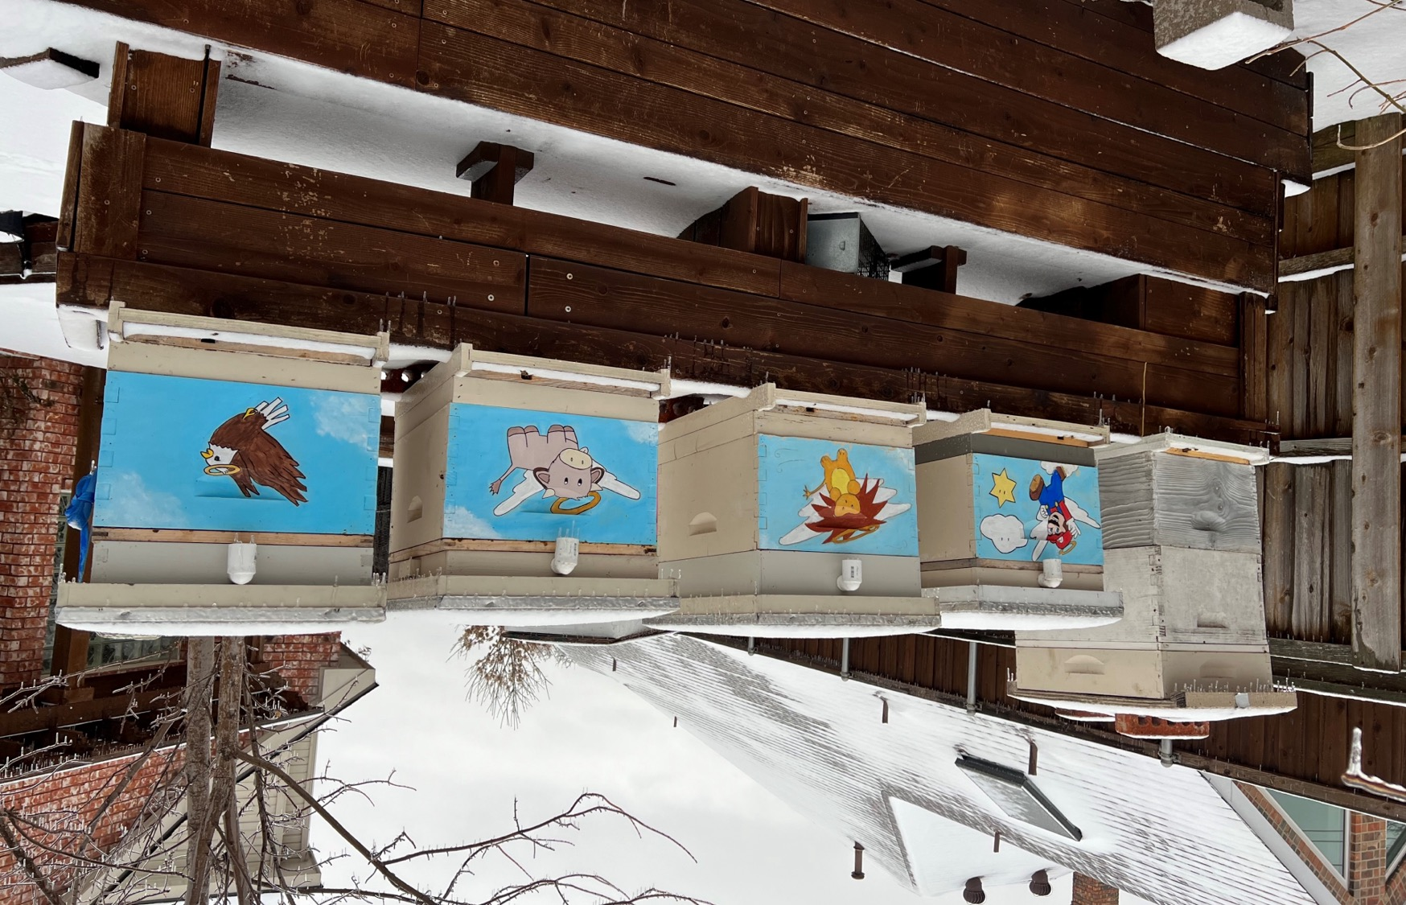

Single Brood Chamber Management – More Honey for the Money!
Presented by: Reuben Chen
February 9, 2026

Slide 2

My Qualifications….
“I’ve been beekeeping since…. the Queen Color was Red.” (2018)
Disclaimer: Beekeeping is very geographical and climate dependent. Every beekeeper develops their own way of doing things and this is how I’ve done it. I’ve borrowed, modified, and integrated what I’ve learned over the years for beekeeping in my backyard in Plano, Texas.

Slide 3
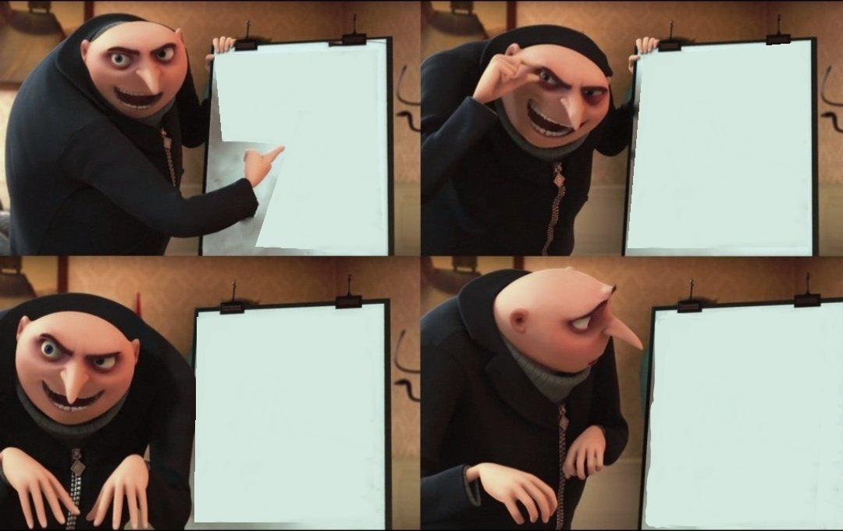
How did I get here? First year of Beekeeping…
Step 1-
I want to get just
ONE hive.
Oooh! Somebody has
a swarm!
Maybe I just get ONE Hive
and a Nuc…
Fine…
TWO hives and ONE Nuc….
That’s ALL!!!
How come I have 17 hives?!?!

Slide 4
How did I get here? First year of Beekeeping
My original plan was to have one or two hives.
Didn’t know whether to do singles, doubles, or a “deep and a half”
My mentor said, “More bees = more honey.” (So double deeps it is!)
BUT I couldn’t get the bees to draw any comb. (It was Summer dearth and all my feeding was just going into storage. Plus the other rookie mistakes.)
Sulked and concluded that I was a complete failure at beekeeping.
(This usually happens in August/September… beekeeper doldrums)
Entered the first winter with just 2 single deep hives and a prayer.
Surprise! They survived the Winter!
With Spring, I just decided to go for honey production rather than build out another deep because I was lazy, impatient, and drawing wax was hard.

Slide 5
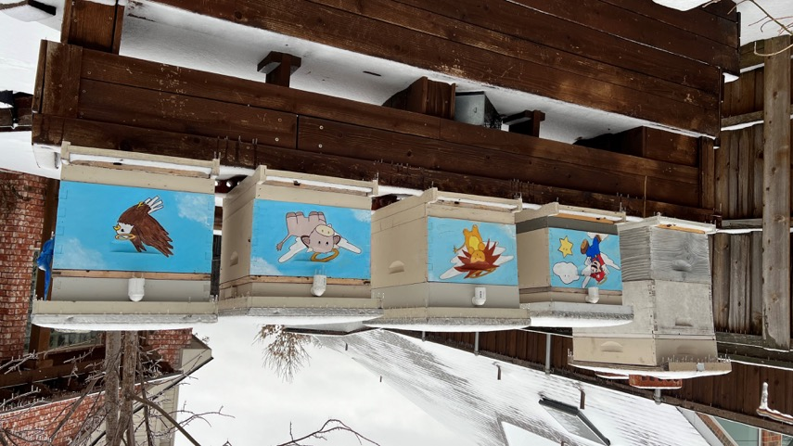
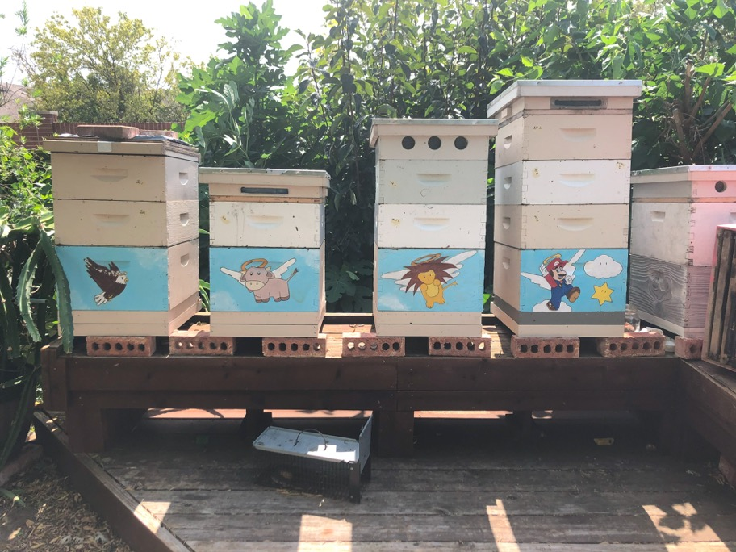

Holy Family Apiary
(left) February 2022
(below) Summer 2022
I see that Double Deep…..
(I promised my parents just 4 hives.)

Slide 6
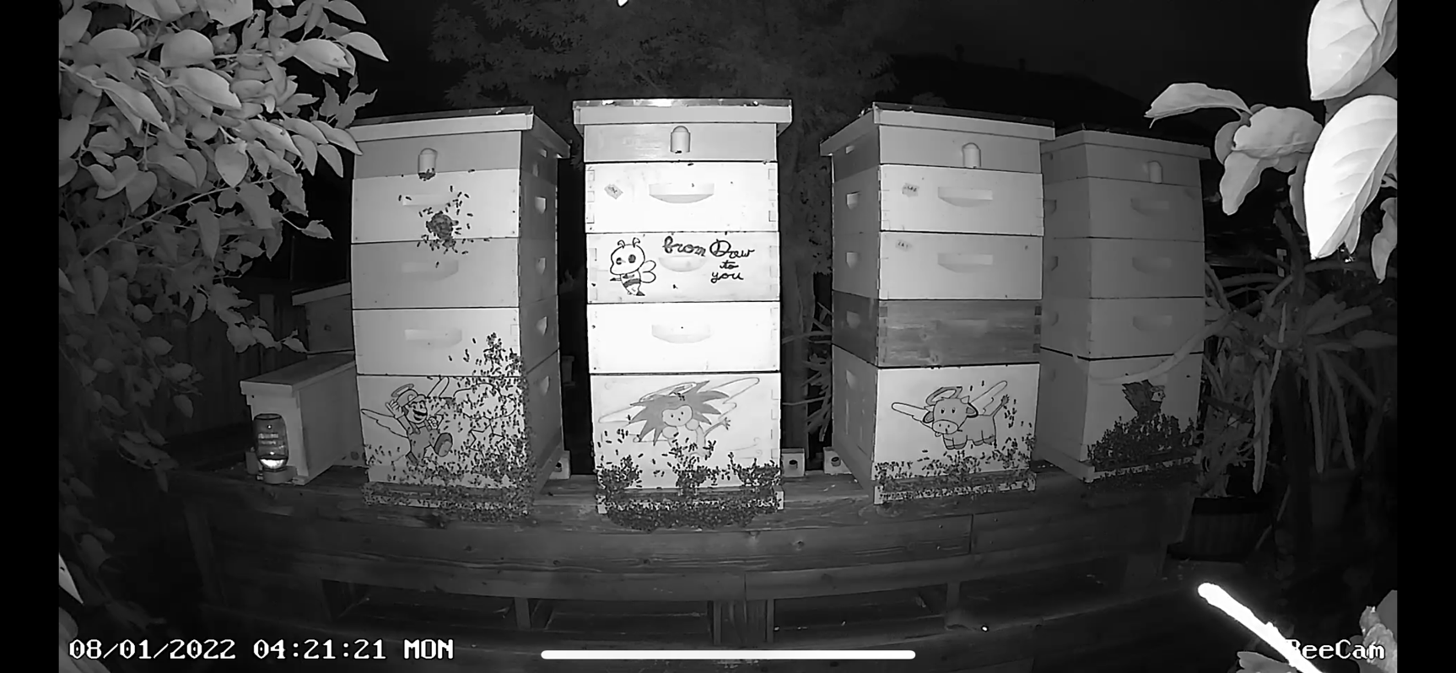
Apiary at Night!

Slide 7
So What is
Single Brood Chamber Management?

Slide 8
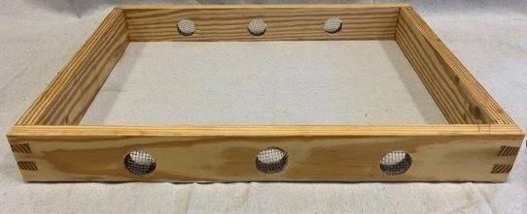
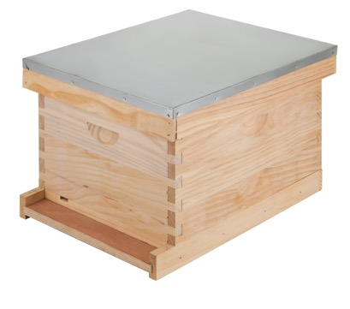
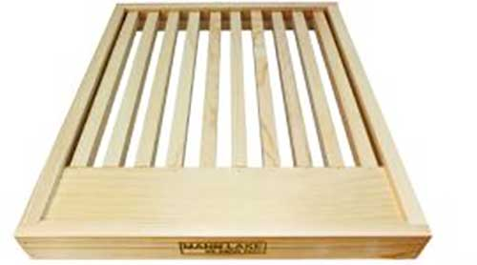
What is Single Brood Chamber Management?
Beekeeping with an emphasis on consistently maintaining the brood and queen EXCLUSIVELY in a single Deep hive body; INCLUDING the winter months.
Honey Super sizes can vary between Deeps, Mediums, or Shallows. Beekeeper’s choice. It doesn’t matter what’s above.
Queen Excluders are required during the flow.
Possible use of Vent Boxes or Slatted Racks (more later)
I do not know if this will work with 7-frame or 8-frame deeps. But the method is similar.
NB: Anytime absolutes are used, assume there’s always exceptions and a good way to learn is to always ask, “Why?”

Slide 9
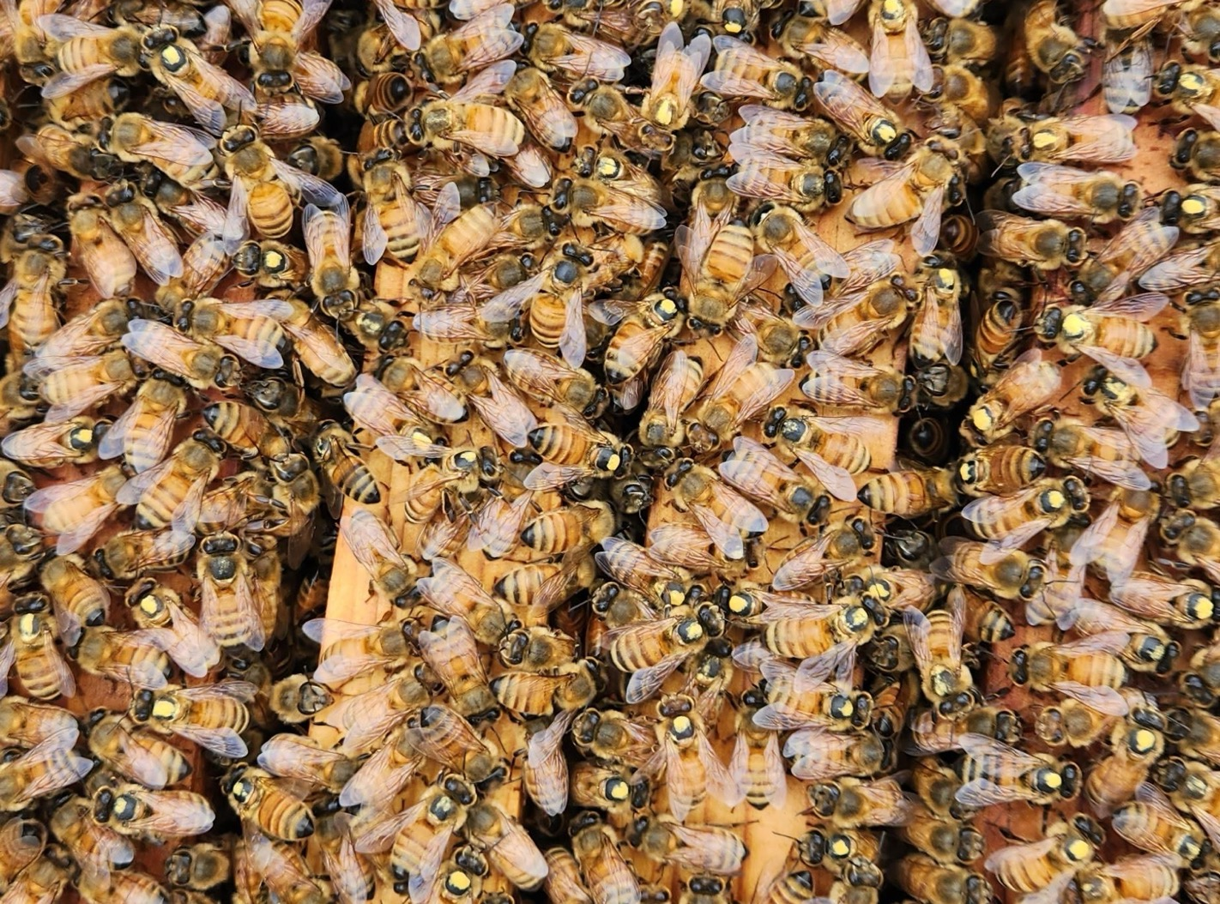
Why Single Brood Deeps?
Because I like them.

Slide 10
Pros and Cons
Pros:
Only one deep = 10 less frames to inspect!
Easier to find queen! And probably less chance of losing/killing the queen too
Easier to “track” the shape of your brood box
Almost NEVER having to lift a full deep (60-80lbs); inspections only require lifting the honey supers off (20-50lbs)
Cheaper? Don’t have to buy a deep box and frames for every hive. Or can run more hives!
“Mediocre” Queens? SURE!
Mean genetics are noticeable sooner.
Two HARVESTS?? YES! FTW! (Always a fall harvest)

Slide 11
Pros and Cons
Cons:
Swarm Prevention requires more frequent inspection (every 2wks max, in season)
More expensive? Maybe for buying optional slatted racks, queen excluders, and vent boxes
Lack of frame selection – less resources to make splits and or exchange/balance.
Lack of information because you’re doing things differently
e.g. When do I pull supers in the Fall? How much honey do I need for Winter? Varroa treatment dosages?
Over Wintering Strategies

Slide 12
Single Brood Chamber Management
Some of the biggest issues/questions people have with Single Brood Chamber Management.
Swarms and Size of the Colony
Honey Production
Overwinter Protocols
IPM – Integrative Pest Management (ie. Varroa Control)

Slide 13
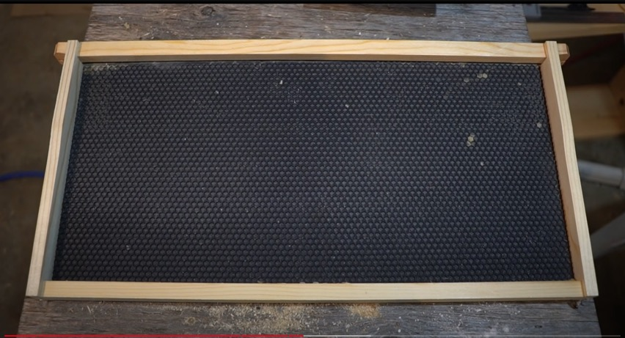
Biggest Issues - Swarms and Size of the Colony
One Side of One Frame
80 cells x 44 cells = 3,520 cells
Whole Deep Box (10 Frames)
3,520 cells x 20 sides = 70,400 cells
Queen Lays ~1,500 eggs a day (Maybe up to 2,000)
Brood takes 21 days to emerge from cells
@1,500 eggs/day – 31,500 cells are needed;
Approximately 50% of cells is brood
Rest of the Cells
20-25% Honey Stores
20% Pollen Stores
?Drone Brood?
Source: Devan Rawn – “Why Managing Bee Hives as a Single Brood Chambers Works”
https://youtu.be/YjyNcyVvbEI

Slide 14
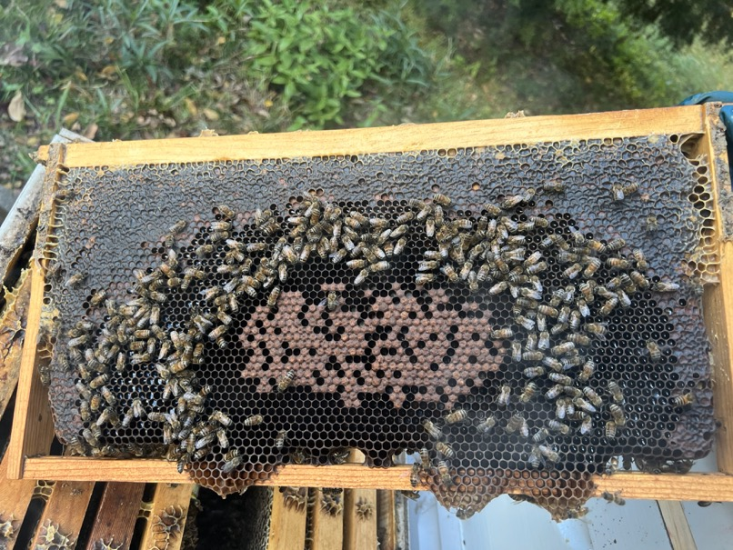
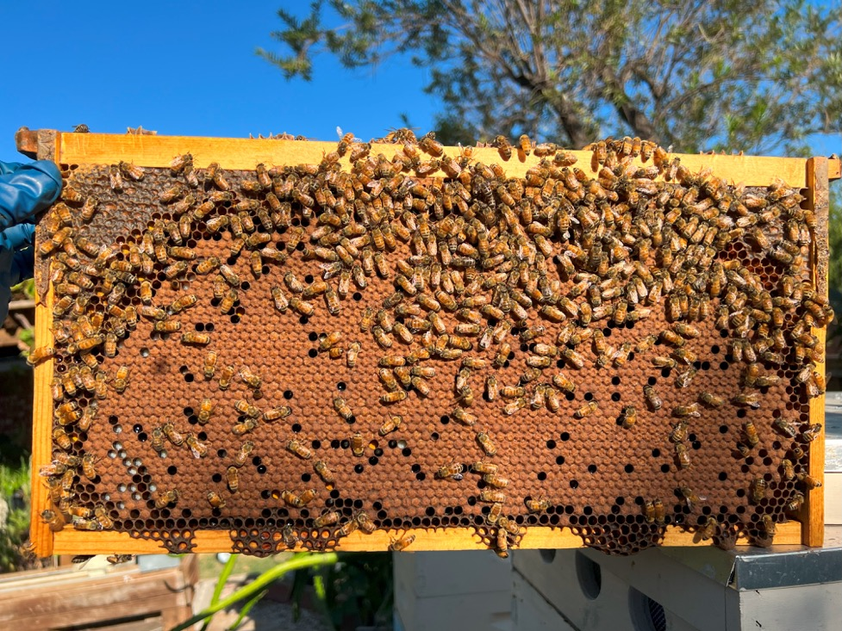
Summer Brood vs Winter Brood
Above: November 9, 2022
Left: September 14, 2022

Slide 15
Biggest Issues w/ Single Deeps
Swarms - My Experience
Not that often! Estimating maybe 10x or so.*
< 5 were because of space issues; “True Swarms”
2025 Spring had 3 swarms b/c lack of attention (space)
Mostly “swarms” happened in Fall. BUT could also be called supercedure (I’m unsure.) I decided they were “fine” and I didn’t need to inspect – and there was clearly an umarked queen running around.
But…..Don’t bees swarm in Double Deeps too? ☺
i.e. We are always looking out for Swarms, especially in Spring; Double Deeps don’t make you immune to swarming
Minimizing Losses (similar for Double Deeps)
Backup Nucs to support your production hives
Find your “Queen Guy” – somewhere you can get a queen quickly and locally to minimize down time
*NB: It’s hard to admit that I don’t know the exact reasons for what happened. Queen went missing. Could have been a swarm, or supercedure, or emergency.
All my strange queen issues have been in the Fall when I am tired and busy and haven’t been keeping up with my bees.

Slide 16
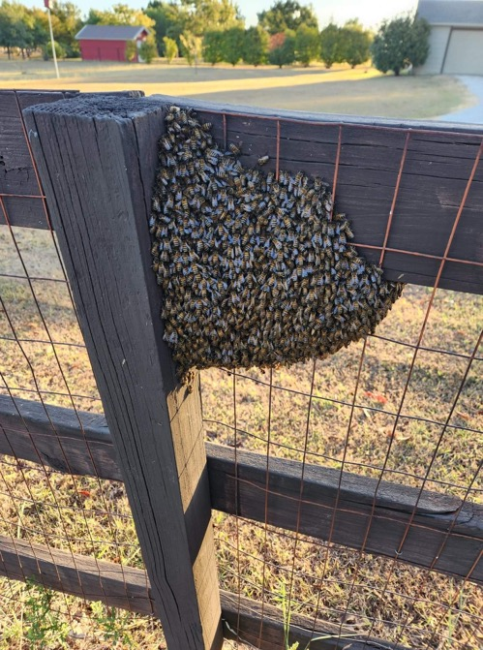
Biggest Issues w/ Single Deeps
Preemptive and Prophylactic Swarm Measures:
Keep 2 frames of resources (honey) on the outside. Once they cross that threshold, it’s time to think and plan about taking action.
Once they reach 10 frames of brood, you can pull out 1 or 2 frames of brood to make a little NUC split; even raise your own queen. Swap in 1 or 2 frames of comb to keep things going or add foundation to build out. (“Nuc”-lear Option? heheh ☺)
“Nuclear” Option - Removing Queen Excluder (QE) to allow the queen to wander up for a little bit. Then adding QE back when the danger is over. Similar to a “Demaree Split”
If I see queen cells (not cups), I knock those down to buy time (assuming queen is still running around) and go ahead and make a small split; usually leaving old queen in place. Main goal is to reduce population
This guy should have done something earlier….. ☺

Slide 17
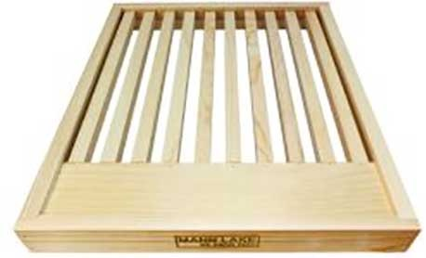
Increasing Space for Single Deeps - Slatted Rack
Positives -
Primarily a “Northern Thing” (cf. Etienne Tardiff –Yukon Beekeeping)
Extends the bottom of the Hive (temperature buffer)
Allows the Queen to lay the full frame
Good in Summer – “reduces” bearding (kinda)
Good in Winter – space away from entrance, not as drafty
Makes other newbies look at you like you know what you’re doing.
Negatives -
Another piece of equipment - $20-25/ea?
Bees (eg. the queen) sometimes hides down there. (i.e. you have a lot more bees than you think!!
Makes other people think you don’t know what you’re doing (in Texas, at least).

Slide 18
Vent Box – Attic Box – Feeder Box – Quilt Box
Positives:
Space for feeding because there’s no space for a feeder. (e.g. I use Ceracell)
Top Entrance, if added, provides quicker access to honey supers
Heat Buffer for the Summer sun; vent, if added for heat dissipation (may reduce bearding)
Can add burlap and other insulation material for winter. (cf. condensing hive vs. vented hive)
Negatives:
$$ - Another piece of equipment
Possible ingress route for SHB
Ongoing Vent Box Project Goals:
Top Entrance – emulating Guardian SHB Gate
Feeder Compatible
Winter – Moisture regulation/insulation
Summer – Ventilation to reduce bearding
Propolis Trap Compatible
Inner Cover Integrated
Win PowerBall Lottery

Slide 19
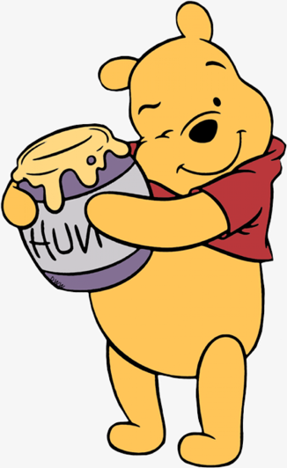
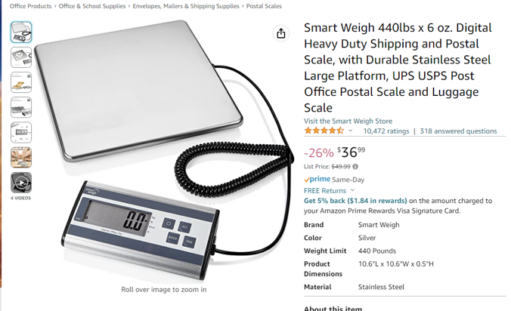
Less Bees = Less Honey?!?! NOPE!
Honey Production Per Hive Averages for
Matthew, Mark, Luke, John
2019 – 69.9 lbs
2020 – 43.4 lbs (Cinco de Mayo Cold Snap, only 92lbs for Spr)
2021 – 63.52 lbs (Snovid. Reset down to 1 hive)
2022 – 166.95* lbs!!! (Total of 717 lbs – incl auxiliary hives)
2023 – 176.02 lbs (My Best Year - 880.1 lbs harvested)
2024 – 107.95 lbs (Really snoozed here –only 80.6lbs in Fall)
2025 – 128.82 lbs (5/6 hive average, 644.1lbs)
Postal Scale – weigh supers every hive check to track trends
3 Mediums per hive – Each with 9 or 10 frame configurations.
Sometimes not enough… needed to borrow boxes from friends!
Despite having record heat waves in past years, bearding seems
to be minimized

Slide 20
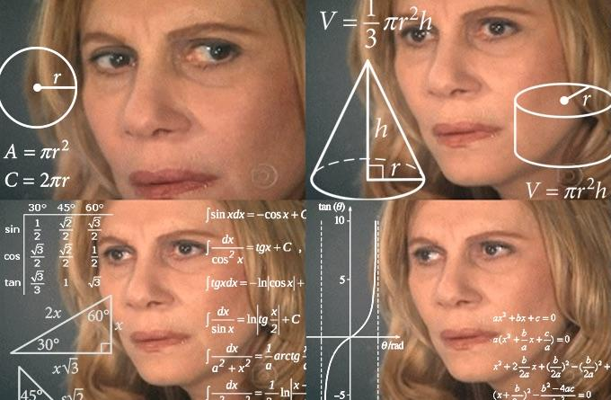
Over Wintering Protocol for Doubles
According to Texas The Bee Supply:
“Recommends about 30-40 lbs of stores in the top box. And ANOTHER 3-4 frames of honey (which is about 30-40 lbs) in the bottom.”
This is about 60-80lbs of Honey in the hive that you will never see!
Lots of money buying sugar to meet those weight requirements. ($14.50 for 25lbs at Kroger)
Larger hive going into winter may have more bees and room, but also requires more mouths to feed.
BUT maybe less total energy expended? Complicated math problem…..
If the hive dies, the honey frames aren’t usually used for Spring extraction. It’s just fed back to the bees.
In Spring – bees need to backfill two deeps back to 80% before even starting work on the supers.
That’s more of your Spring harvest “lost.”

Slide 21
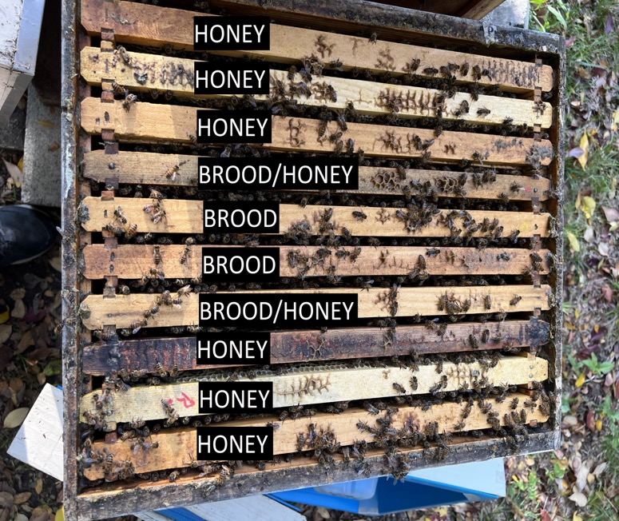
Over Wintering Protocol for Single Deeps
One of the greatest benefit in keeping single Brood Chambers is having a lower overhead for winter preparation. (Will get to more in depth when we walk through the year)
Fall:
Goal: At least 4-6 frames of nectar and honey.
Hive weight around 70-90 lbs. (whole hive)
Remove all supers. Extract and feed back if you want
Winterize supers – freezer, moth crystals, BT.aizawai
Feed liquid syrup (1:1, 2:1, whatever) until it’s too cold, switch to dry sugar; *** More Research Here ***
Pollen subs not really necessary in suburban north Texas.
Although if timed right – could kick off big population
Spring:
Supplement feeding depending on winter temps and stores left. Tricky to gauge – want to feed aggressive, but not so much the bees are honey bound.
After the last frost and honey frames are full on the outside, add QE and Supers!
Fall Configuration: Brood/Comb → Honey
Winter Configuration: Honey→ Brood/Comb
Early Spring: Comb/Honey → Brood

Slide 22
Single Brood Chamber Management
Some of the biggest issues people have with Single Brood Chamber Management.
Swarms and Size of the Colony
Honey Production
Overwinter Protocols
IPM – Integrative Pest Management (ie. Varroa Control)

Slide 23
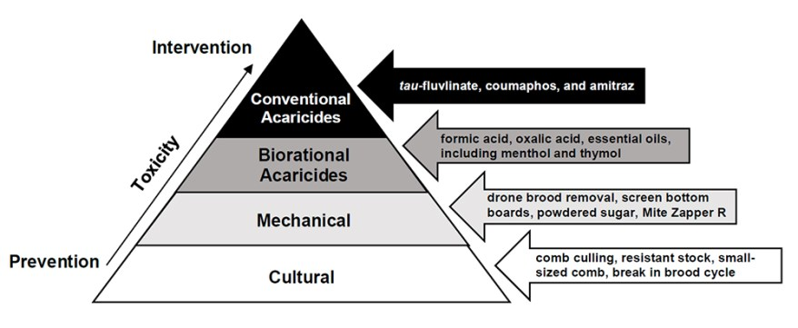
Integrative Pest Management - Varroa
Obligatory IPM Pyramid

Slide 24
Integrative Pest Management - Varroa
Research and weigh out what will work for you
Time/Efficiency, Costs, Use of Chemicals, Side Effects, Season– lots of trade-offs; what are your priorities?
Many treatments have conditions
Must be within a temperature range, or without honey supers
Read the label
Dosage may be halved because you are only treating one box.

Slide 25
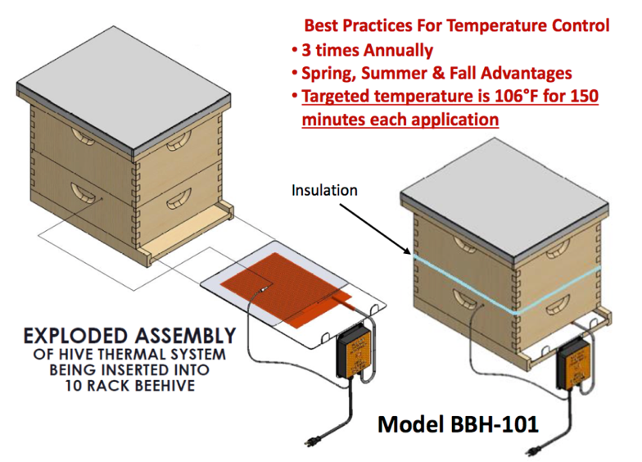
My IPM for Varroa Mites: “I’m pseudo treatment-free.”
My Opinion: Survivor stock is the *only* way apis mellifera will overcome every major invasive disease and pest. The Proof is simply that we aren’t treating for anything else that’s plagued us in the past.
Use survivor stock genetics – feral bees or from good local queen breeder that’s Treatment Free.
Trade off between “mean bees” and “varroa resistance”
Better adapted to climate swings in Texas.
In July or August: One Mighty Mite Thermal Treatment Oxalic Towels (cf. Randy Oliver)
Available to rent from TVBA for members ($30)
Requires about 3 hrs of treatment plus setup time.
Mite wash before and 10 days after
https://pdnbeekeepers.org/mightymite/

Slide 26
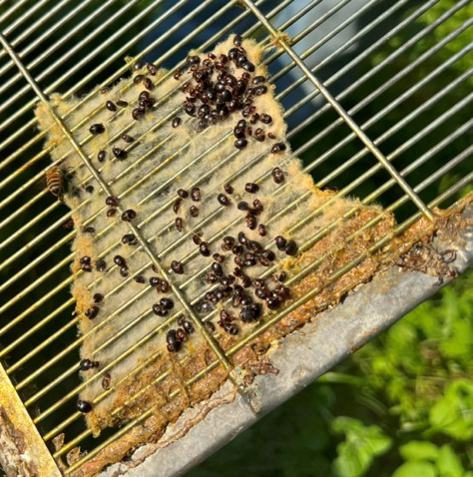
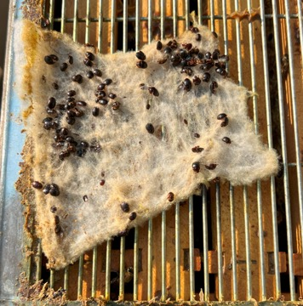
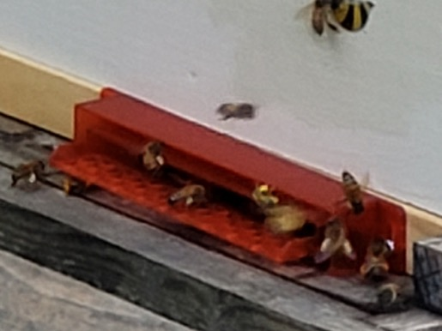
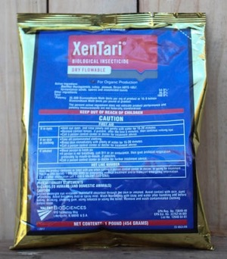
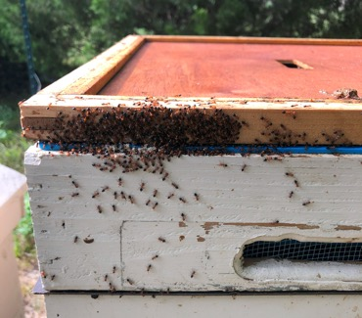
Integrative Pest Management – Other Pests
Small Hive Beetle
Swiffer sheets – ¼ sheet in the corner, above the QE
Guardian Hive Beetle Entrances
My hive tool
Wax Moth
BT.aizawai / Xentari / Certan – Seven Springs Farm – lifetime supply.
Ants
Yuck. I just squash.
Do Nothing.

Slide 27
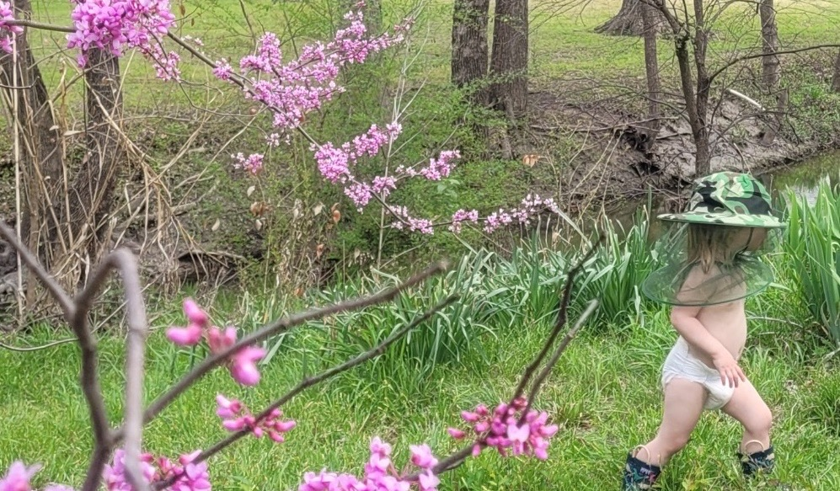
How do I run my hives?
Calendar walkthrough of my hives

Slide 28
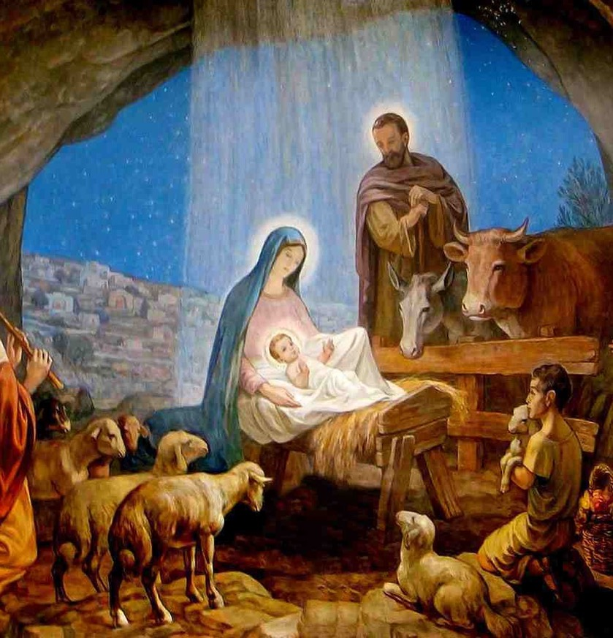
Disclaimer
Every beekeeper develops their own way of doing things. I’ve borrowed, modified, and integrated what I’ve learned for beekeeping in my backyard in Plano, TX. This can and will be modified on the fly for any good demonstrable reason. Take it or leave it – whatever works for you!
“Beekeeping begins in August….”
-Some Smart Commercial Beekeeper
“Beekeeping starts whenever you have bees. But I’ll start at the Winter Solstice.”
-Not as smart Hobby Beekeeper (Me)

Slide 29
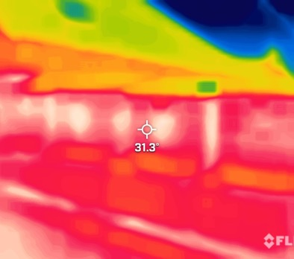
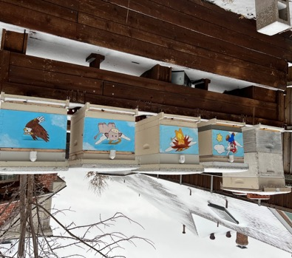
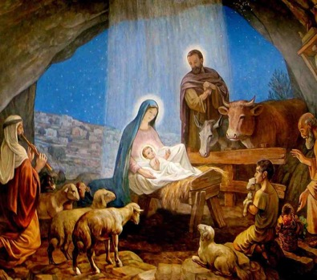
December 21 – Winter Solstice
The darkest day of the year. The days will get longer until the Summer Solstice. Bees generally follow this pattern. (Except when the weather doesn’t)
Bees are clustered when it’s cold and laying is largely shut down.
Brief warm spells could induce some laying, but a pollen and nectar flow is needed to have something sustainable.
Remember it takes 21 days of incubation (brood covered and temp maintained) to raise an adult bee.

Slide 30
Winter Thermodynamics – Still Researching
Heat Rises; Moisture forms on cold surfaces (Dew) in warm air
Ventilation & Moisture
Old Convention
Moisture – It’s bad, it’ll rain and drown your bees. Get rid of moisture, tip your hives, use vent boxes with burlap to wick away moisture.
Insulation? -- “Cold Front coming… What do I do? We’re in Texas, don’t do anything. If you insulate, you’re a dummy.”
But also, “Apimaye is the best hive there is because they have great insulation.”
If you insulate too much, it’ll get too hot and they’ll eat up all the food, and then they’ll starve. ☹
My Current Theory – Insulation is the Key to success.
Texas may not get cold enough to need insulation like the Canadians.
Ventilation, while carries away moisture, also carries away precious heat that the bees have generated.
Higher CO2 levels produce torpor – lowers metabolism and honey consumption.
Conclusion: Don’t Ventilate, SEAL.
Condensation will happen regardless – but WHERE the condensation happens is important!
Insulating the top side of the box significantly more than the sides will cause the condensation to form on the sides rather than the top. Preventing Hive Rain.
Bees need that moisture to process sugar bricks and honey and sustain life (they don’t go outside)
Placement of SugarBricks in the top center will centralize the cluster. They can eat without having to go to neighboring frames to get food during cold fronts.

Slide 31
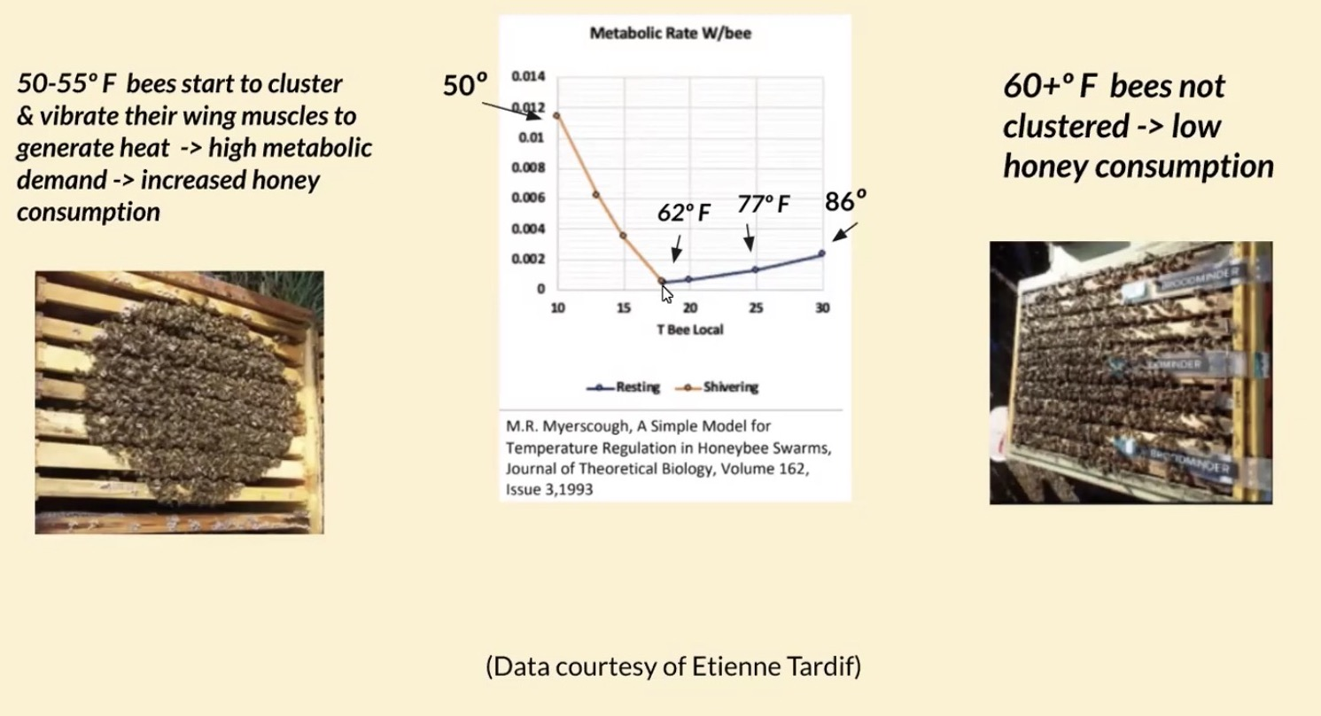
Youtube – Hive Hugger by Peggy DeSanto
14F – Bee’s Cluster is tightest

Slide 32
December 21 – Winter Solstice - January
What the Bees are Doing
What I’m Supposed to Be Doing
They’re waiting to brood up. Maybe 1 or 2 frames of brood.
Bees will cluster and occupy maybe 3-4 frames
As days get warmer, more frequent trips out and foraging.
Depending on genetics of the colony: brood rearing may be completely shut down or bare minimum crew, early start or late start.
Maybe a hive check on a warm day. (2wks)
Making sure they haven’t gone through their food stores
Feed sugar if necessary (won’t be warm enough for liquid feed)
Pay attention to cold fronts – “panic!” and then respond accordingly…
Get equipment and storage area squared away and prepped for the Spring

Slide 33
February
Generally, our coldest month in North Texas. Watch out for that 2nd/3rd Week!
What the Bees are Doing
What I’m Supposed to Be Doing
With a warm winter, brood may already be coming in. Still may be 2-3 frames of brood.
Bees occupy about 4-5 frames
Sudden Cold Fronts (<32F)– may cause disruptions in brood rearing.
Depending on length of freeze (overnight or more than a few days) – bees will need to decide: save/cluster the young brood or survive by clustering over honey?
Hive check every 7-10 days.
Newbies – good to check weekly to learn to see the changes and rate of development.
Feeding – (2:1, 1:1, sugar bricks, fondant)
Again, making sure not to overfeed causing them to be honey bound.
Pollen – Looking for Elm, Red Bud, Bradford Pear, Henbit, Dandelions, Clover, etc.
Feed pollen subs only to stimulate brood rearing – but if pollen flow, it’s not needed.
Unseasonably warm February – throw on a super for giggles.

Slide 34
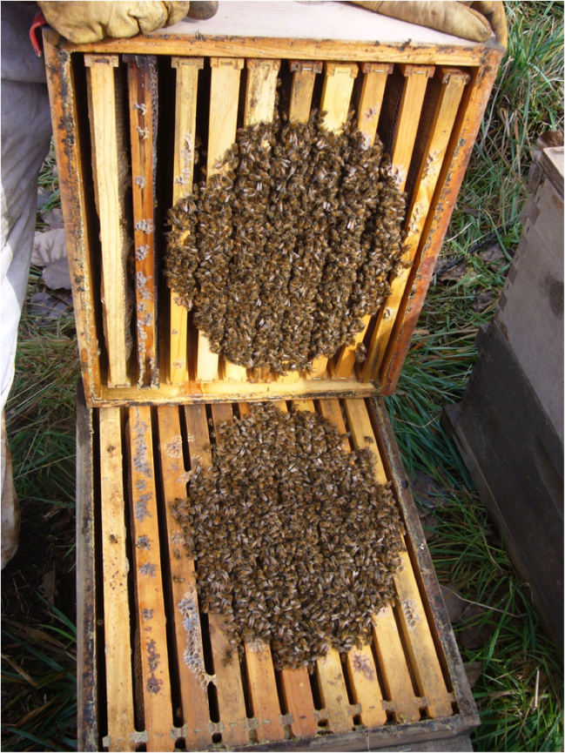
Winter Cluster
How many frames of bees?
What’s the brood size?
Recommendations vs Reality
http://fitzgeraldsfamilyfarm.blogspot.com/2014/03/are-bees-clustered.html

Slide 35
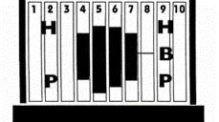
March 20 – Vernal Equinox
Longer days and warmer weather, rain; lots of flowers are starting to bloom
What the Bees are Doing
What I’m Supposed to Be Doing
Bees actively brooding up, 4-6 brood frames.
Regular trips out and foraging what they can.
Should see steady pollen coming in
Drone brood laid towards the end of March
If really doing well, AFTER drones are laid, colony will start on queen cells
Hive checks every 7-10 days
Feeding, if necessary
Pay attention to brood size. Will start as a small oval shape across a few frames.
Oval grows bigger to the “Rainbow shape”
Keep the outer edge frames honey/nectar
Consider splits if growing too strong

Slide 36
April - Easter
More consistent warmer weather rain, last cold front. Nectar and Pollen flow!!
What the Bees are Doing
What I’m Supposed to Be Doing
Bees should be up to 6-8 frames of brood.
Laying drone brood
“Start” of Swarm Season
Good flow of Nectar and Pollen should be coming in
Weekly hive checks; 10 days at the most.
As soon as nest approaches 8 frames of brood… QE and honey supers go on!
If drawing a new foundation box, DO NOT use QE.
If drawing a super box, use QE; CHECKERBOARD frames to promote even comb development.
If really aggressive growth, put on two supers
Look For: new burr comb/wax – white color
Construction bees are 12-17 days old
Consider splits if growing too strong – pulling a frame or two of nurse bees/brood

Slide 37
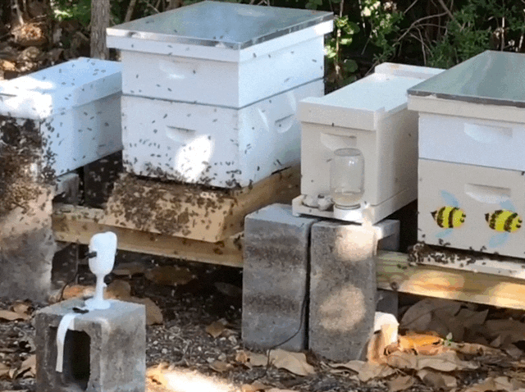
April - Splits
If growth is strong or you need to expand, consider splitting…
Single Deep Swarm Mitigation –
Robbing a frame or two of brood in a hive to decrease the population.
Brood frames can be used for fortifying weaker hives or starting a new one.
Mating nucs can be small as one or two frames during the spring brood up.
New frames in can swap out old frames
Based on what you will do with them, pick either the young or old (capped) brood frames.

Slide 38
May
Nectar flow is in full swing. Rain hopefully will not wash out nectars and pollens
What the Bees are Doing
What I’m Supposed to Be Doing
Bees are now at 8-9 frames of brood.
Colony needs/wants to lay drone brood
Swarmy!
Nectar flow should be in full swing
Average weekly weight gain: 10-12 lbs
Exceptional can get up to 25lbs/wk
Record: +37.6lbs in one week, extracted nearly 300lbs (4 hives), May 6.
Weekly hive checks; 10 days at the most.
See April.
When super is 80% full, add another. I prefer bottom super-ing.
If frames are undrawn, put on sooner. Maybe @ 60%?
Weigh supers to track progress. I’m taking them off anyways, might as well put them on the scale.
Always be looking for swarm cells and supercedure cells.

Slide 39
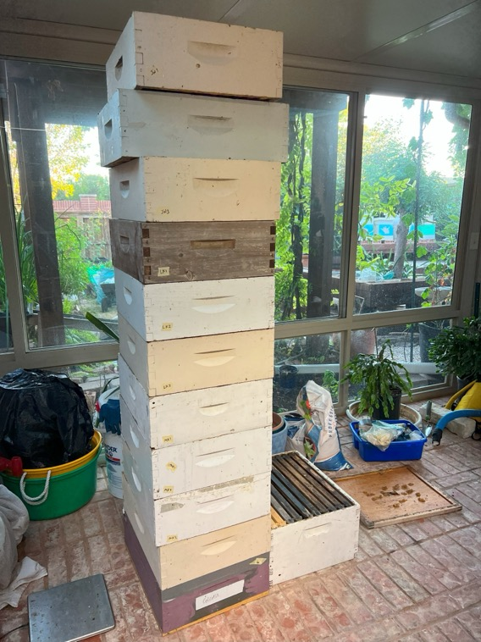
Super Weights!
Medium – 10 Frames, plastic foundation
Undrawn ~12lbs, Drawn ~14lbs
Full Super – 40-60 lbs
Ready for extraction @40+lbs
30-40lbs can be iffy before July
“Manual” scale:
15-25 lbs – “Hey, there’s some nectar in there.”
30+lbs – “Unfff…” – I’m going to extract soon!
40+lbs – “Ooooof!”- Why am I a beekeeper again?
50+lbs – “Huuugugghh!” – “$$$$”
Deeps can weigh between 80-100lbs, probably good to extract around 60+lbs
5 gallon buckets: 55-60lbs (depending on how full)

Slide 40
June 20 – Summer Solstice
Longest day of the year. Flowers still blooming, but dying off by the end of the month. Getting hot.
What the Bees are Doing
What I’m Supposed to Be Doing
They know days will be getting shorter after solstice. Urge to swarm is still present.
Bees are now at 9-10 frames of brood.
Nectar flow tapering off. Some years, the supers start losing weight now.
Outside honey frames are now being filled with pollen and brood instead of honey
Weekly hive checks; 10 days at the most.
See April and May.
Bare minimum is to weigh the supers.
Not unusual to see plenty of queen cups, but not too many queen cells.
Maintain brood chamber at 9-10 frames of bees. Would not hurt to siphon off frames to build nucs or fortify other colonies.
Supers can be extracted by the end of the month

Slide 41
July 4 – Extraction!
Usually I extract around this time. Dearth.
What the Bees are Doing
What I’m Supposed to Be Doing
Dearth is approaching if not already present.
Full 10 frames of wall to wall brood.
Irritable bees.
Bearding not uncommon
Honey Supers tend to lose weight
Can lose average 3-5lb/week.
Hive Checks ideally every 7-10 days.
Since it’s hot, I tend to get lazy here… Maybe up to 14 days.
Supers weighed and extracted.
After extraction and depending on condition of brood box, may need to start supplemental feeding.
Trickle Feeding = 1-2 qts/wk 1:1 sugar syrup*
If swarm cells, will need to take action. I prefer to simulate a swarm.
End of the month will do mite check and treatment.
*Blake Shook’s Recommendation – pollen for the week and 1/3-1/4 gallon per week

Slide 42
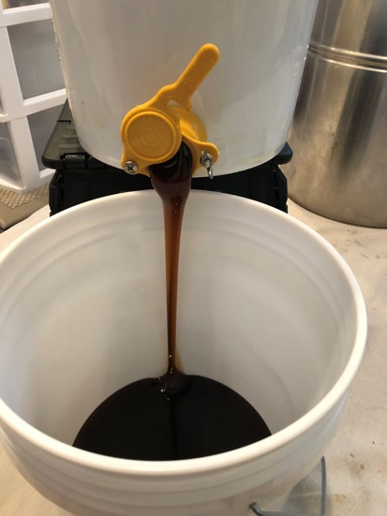
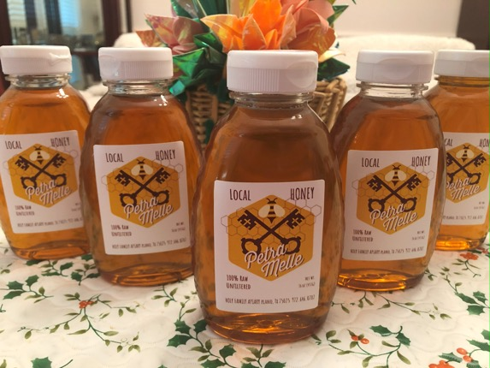
July 4 – Extraction!
Single Brood Box Conundrum….
With supers off, won’t there be a lot of bearding? Yes.
Option A: Half and Half
Option B: All in
Extraction over 2 days.
Take off the full supers and extract.
Swap the half full ones with empty wet ones.
Extract and replace.
Profit.
Either over a few days or in one day
Take every super that is greater than 25 lbs.
Extract.
Replace Supers.
Profit.

Slide 43
Holy Family Apiary Hive Weights
Notes:
2019 - 69.9 lbs
2020 - 43.4 lbs (Cinco de Mayo Cold Snap, only 92lbs for Spr)
2021 -- 63.52 lbs (Snovid. Reset down to 1 hive)
2022 – 166.95* lbs!!! (Total of 717 lbs – incl auxiliary hives)
2023 – Matthew, Mark, and Luke had issues in Fall but were subbed with Bernard, Takashi, and Neighbor

Slide 44
August – DEARTH!
Hardest part of the year for the Bees and the Beekeeper
What the Bees are Doing
What I’m Supposed to Be Doing
Dearth is in full swing. Heat may cause brood laying to shut down (eg. 2022)
Irritable bees.
Full 10 frames of wall to wall brood.
Pollen Bound?!?!
Mite Levels are at its highest; hives will overcome or fail here.
Hive checks every 10-14 Days
Since it’s hot – I try not to do too much.
Trickle Feeding
If Supers are still losing weight.
Mite Counts and Treatment with MMK
Do another Mite Count 10 days later
If it’s too high – consider collapsing/combining hive. –I don’t want those genetics
Trying to breed survivor stock.
Win Honey Tasting Contest – at least beat Jerry A.

Slide 45
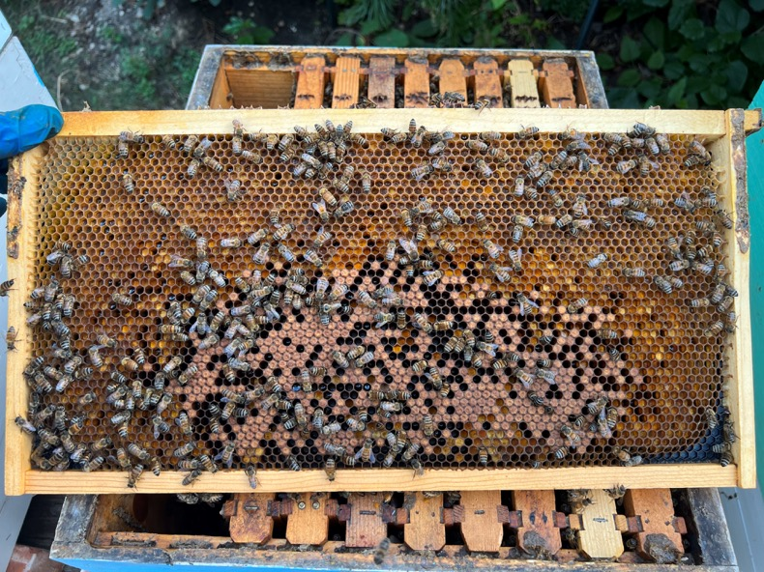
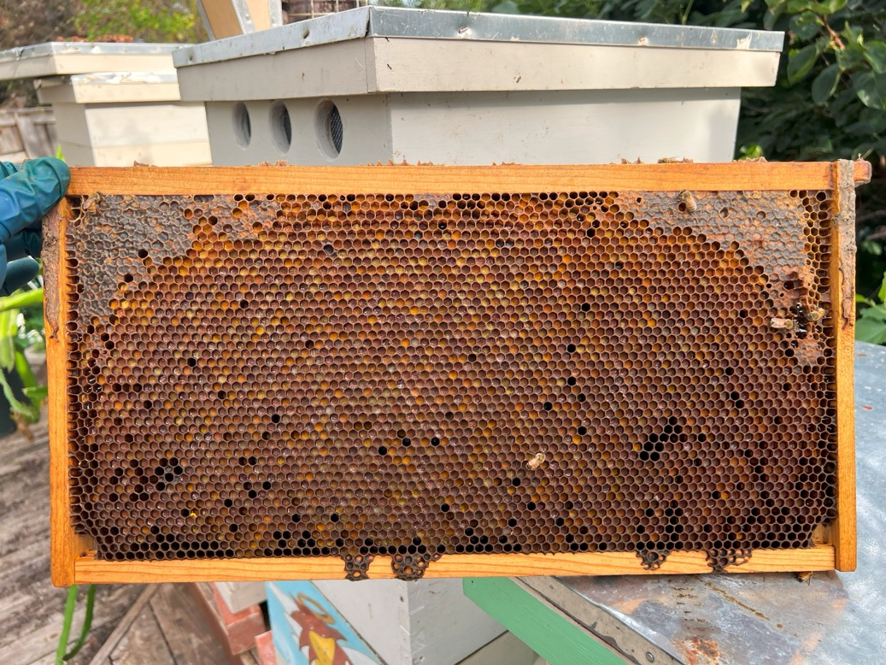

Got Pollen?

Slide 46
September 20 Autumnal Equinox
Night and Daytimes are equal. Bees really know winter is coming. Fall flow? Maybe!
What the Bees are Doing
What I’m Supposed to Be Doing
May see some showers to bring in a Fall flow.
May see a reduction in brood,7-9 frames
Pollen Bound?!?!
Ambitious Suicide Swarms
Back to weekly checks
Learning the hard way – most of my queen losses have occurred here.
Super weights will show whether or not there’s a flow; and if you need to feed
One hive gained almost 30 pounds in a week this year (2025)!
Prepare for Fall Harvest at the end of the month/beginning of October

Slide 47
October – Winter Preparation
Cooler temperatures and shorter days. Anticipating first Frost
What the Bees are Doing
What I’m Supposed to Be Doing
Kicking out Drones
Brood chamber reduces down to about 5-6 frames
Getting the last rounds of winter bees raised
Scrounging for any more nectar as they go into colder weather.
After Supers are pulled, honey extracted, and cleaned up, they are winterized.
Assess and prepare for winter feeding:
Daytime Temps above 60-70s: Sugar Syrup
Otherwise, plain sugar or sugar bricks
Target: At least 3-6 frames of mostly nectar/honey
Brood nest starts to get backfilled

Slide 48
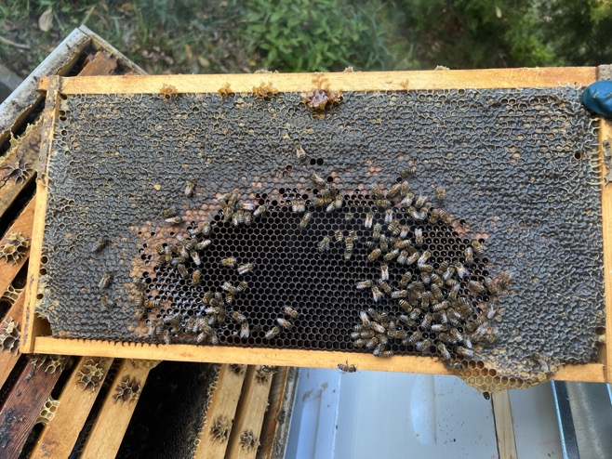

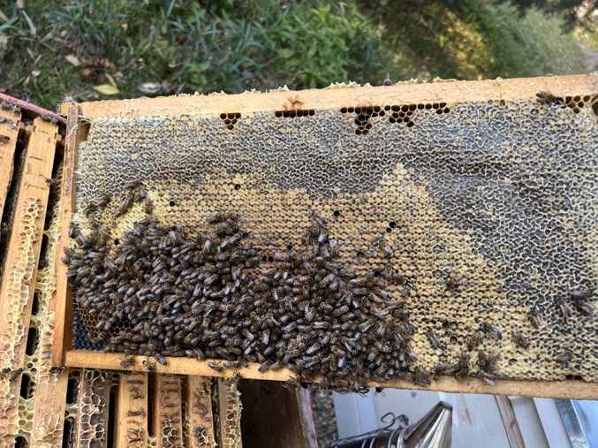
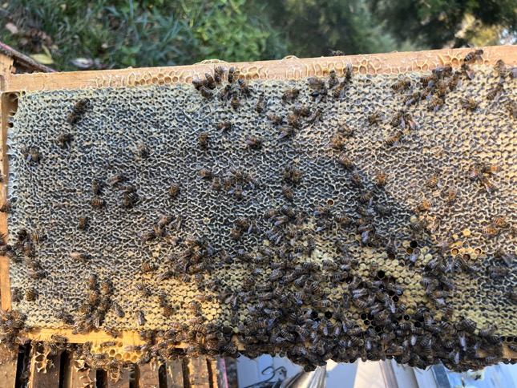
October – Winter Preparation

Slide 49

October – Winter Configuration Goal
Brood Chamber may be off-center or shrink in different spots
Shift so that the brood chamber is centered, surrounded by honey frames
Sometimes the brood gets split by nectar frame
Normally don’t have to correct, they’ll consolidate as the brood ages out
Option: Keep empty frames/drawn comb on sides, instead of that many honey frames
If really weak, can try to overwinter in Nuc OR Use Double Screened Board (aka Snell Grove Board) – Kinda worked

Slide 50
November through December – First Frost and Winter
Plants go dormant. No more flowers. ☹
What I’m Supposed to Be Doing
What the Bees are Doing
Clustering when temps are in <50s
Limited flying and activity.
Staying alive.
Do whatever you missed in October
Hive check maybe once every 3 wks; or longer.
Clean and store equipment, get organized
Review your notes and your year – make note for improvements
Pay attention to cold fronts – take action if necessary
Have Thanksgiving Dinner with friends and family and tell them how your bees did even if they don’t want to hear it.

Slide 51

Over Wintering Protocol
Greatest benefit in keeping single Brood Chambers is having a lower overhead for winter preparation. (Will get to more in depth when we walk through the year)
Fall:
Goal: At least 4-6 frames of nectar and honey.
Hive weight around 70-90 lbs. (whole hive)
Remove all supers. Extract and feed back if you want
Winterize supers – freezer, moth crystals, BT
Feed liquid syrup (1:1, 2:1, whatever) until it’s too cold, switch to dry sugar
Pollen subs not necessary in suburban north Texas.
Spring:
Supplement feeding depending on winter temps and stores left. Tricky to gauge – want to feed aggressivly, but not so much the bees are honey bound.
After the last frost and honey frames are full on the outside, add QE and Supers!

Slide 52
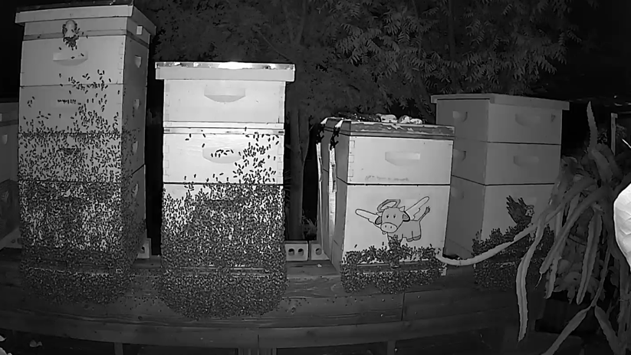
Basic Review of Seasons
Winter
Hive Checks – 1/month
Maintain around 6 frames full of resource honey/nectar, feed if necessary
Winter→ Spring
Regular Inspections ( & watching brood health/growth, feed if necessary
Maintain at least the outside 2 frames with resources; feed can taper off to prevent honey bound
Spring
Weekly checks for swarm cells and brood health
When nest size gets close to the 8th frame of brood, add Super (adjust for drawn or undrawn comb)
Add additional Supers if aggressive growth
Extract around July 4th

Slide 53
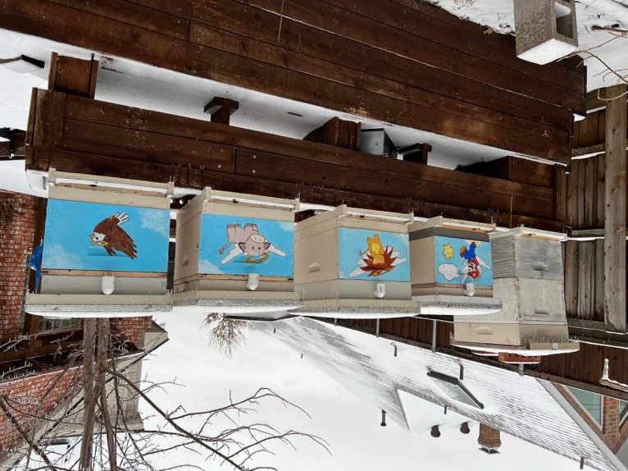
Basic Review of Seasons
Summer
Dearth– “Trickle Feeding” 1-2qts of 1:1 syrup/wk
Weight of Super should be around +/-1.5lbs every week
Basically break even – feed is going directly to sustain bees, theoretically no storage of syrup in supers
Treat for Mites
Fall
Remove Supers
Extract around Oct 1, try to make bees store back into a single deep.
Winterize
Feed for Fall (wet or dry) – 1:1, 2:1, sugar bricks, etc.
Target of 4-6 honey frames
Combine using Newspaper or Snell Grove Board stacking OR…
If too small, move to 5 frame Nuc if too small

Slide 54
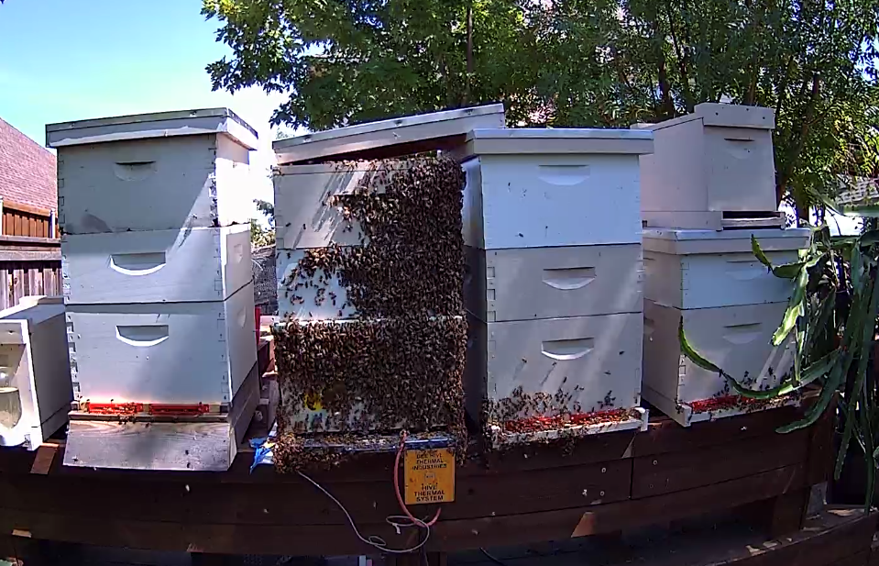
What if I want to Convert? ☺
Just take off your top…. deep!

Slide 55
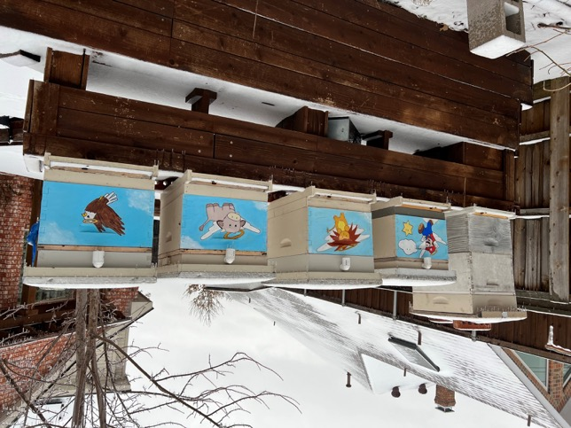
Converting to Single Deep Brood Chamber
When? Probably could do it anytime. But what are the best times?
Early Spring – Making your splits
Divide resources and brood evenly
Buy or raise your own queen to add to QLess hive
Early Fall – Before queens are sold out
Divide resources and brood evenly
Get a queen or raise your own.
Make sure you have enough resources (3-4 even 6 frames of honey)
Any other time – Configure original/source hive to have at least 2 resource frames on the outside, 6-8 frames of brood
Nuc or Second hive – “Beekeeping in Coastal California,” Jeremy Rose “3-5-7” rule for splits:
May - 3 Frames of Brood
June - 5 Frames of Brood
July - 7 Frames of Brood
Cf. “Beekeeping 2.5” by Joe Lewis http://www.susquehannabeekeepers.com/pdfs/LJ_Beekeeping_2.5.pdf
Use of Slatted Rack and Top Vent Boxes aren’t necessary but nice to have

Slide 56

Resources and References
Youtube –
University of Guelph Honey Bee Research Centre
https://www.youtube.com/c/UoGHoneyBeeResearchCentre
Devan Rawn
https://www.youtube.com/@DevanRawn
Bob Binnie, Kamon Reynolds, Jeff Horchoff, David Burns
Facebook –
Dallas Area Beekeepers
Texas Friendly Beekeepers
Honey Bee Single Brood Chamber Management
Honey Bee Suite – www.honeybeesuite.com
Texas Bee Supply – Youtube, Monthly Seminars
“Beekeeping 2.5” by Joe Lewis http://www.susquehannabeekeepers.com/pdfs/LJ_Beekeeping_2.5.pdf

Slide 57
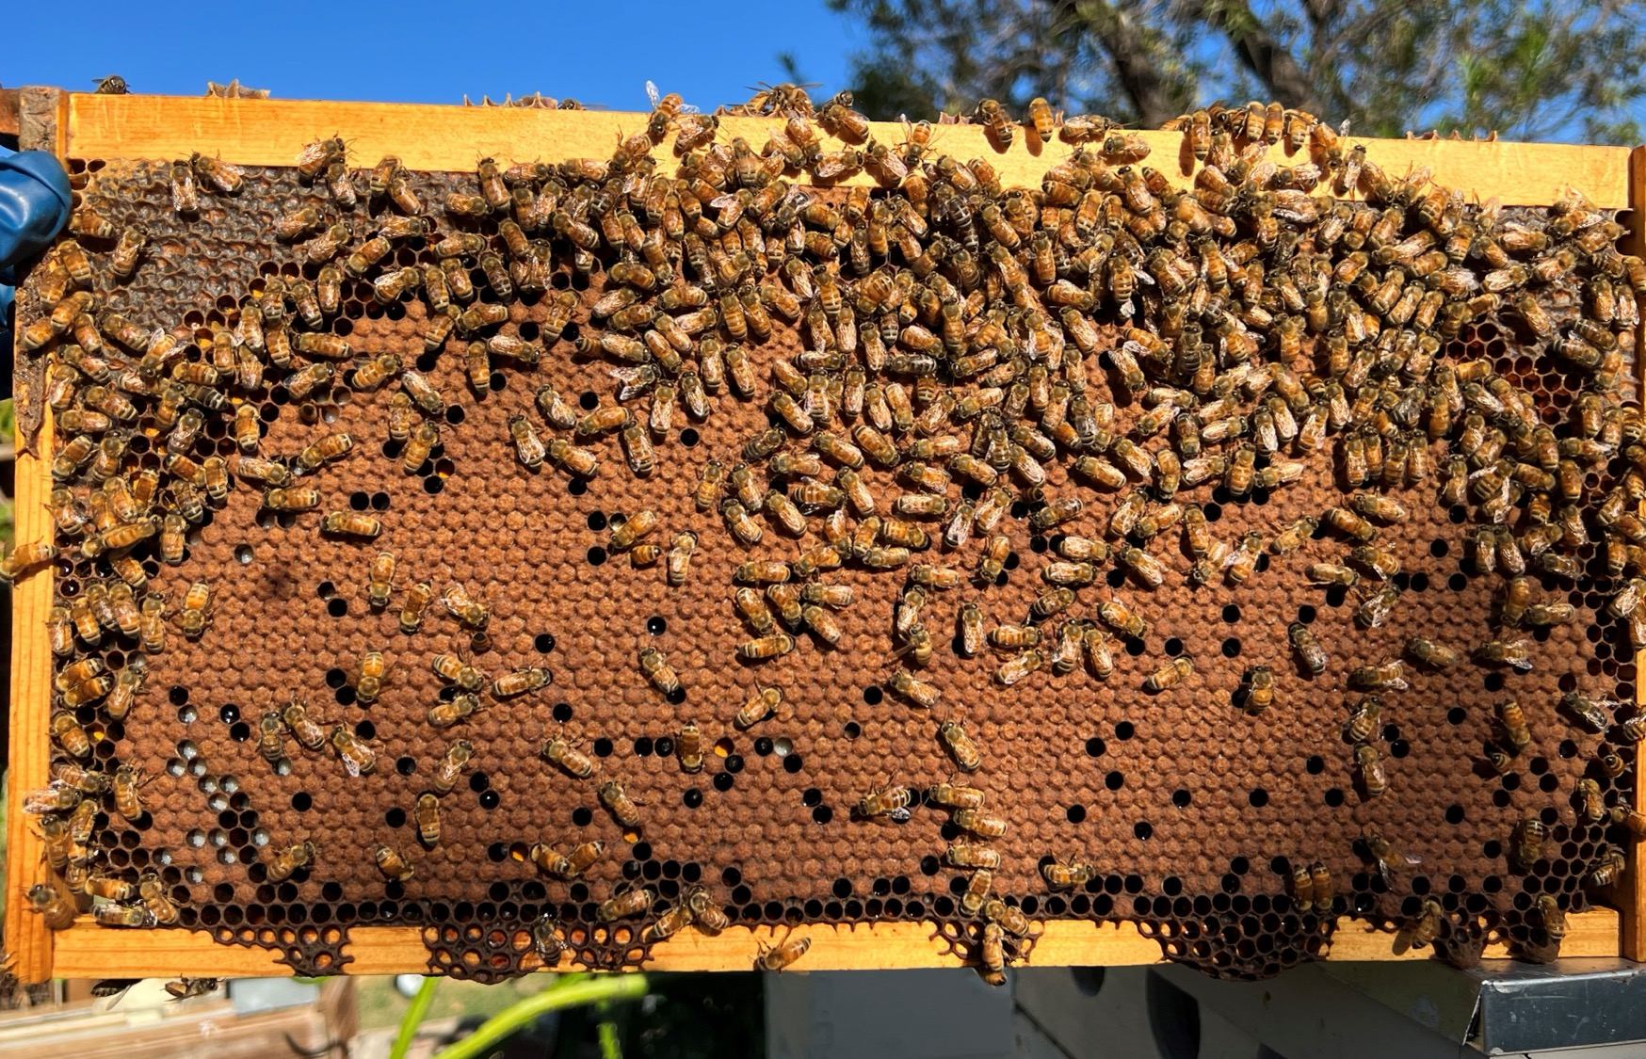




Thank You
Reuben Chen
972-646-0707
reubchen@gmail.com
Petra Melle Honey

